Slide 1
The Business Analysis Core Concept Model

Slide 2
The BACCM ~ Core Concept ~ Change
The act of transformation in response to a need.
Change works to improve the performance of an enterprise. These improvements are deliberate and controlled through business analysis activities

Slide 3
The BACCM ~ Core Concept ~ Need
A problem or opportunity to be addressed.
Needs can cause changes by motivating stakeholders to act.
Changes can also cause needs by eroding or enhancing the value delivered by existing solutions

Slide 4
The BACCM ~ Core Concept ~ Solution
A specific way of satisfying one or more needs in a context.
A solution satisfies a need by resolving a problem faced by stakeholders or enabling stakeholders to take advantage of an opportunity

Slide 5
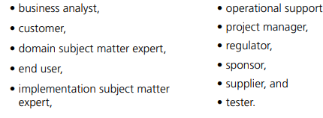
The BACCM ~ Core Concept ~ Stakeholder
A group or individual with a relationship to the change, the need, or the solution.
Stakeholders are often defined in terms of interest in, impact on, and influence over the change.
Stakeholders are grouped based on their relationship to the needs, changes, and solutions.

Slide 6
The BACCM ~ Core Concept ~ Value
The worth, importance, or usefulness of something to a stakeholder within a context.
Value can be seen as potential or realized returns, gains, and improvements. It is also possible to have a decrease in value in the form of losses, risks, and costs.
Value can be tangible or intangible.
Tangible value is directly measurable.
Intangible value is measured indirectly.

Slide 7
The BACCM ~ Core Concept ~ Context
The circumstances that influence, are influenced by, and provide understanding of the change.
Changes occur within a context.
The context is everything relevant to the change that is within the environment.
Context may include attitudes, behaviours, beliefs, competitors, culture, demographics, goals, governments, infrastructure, languages, losses, processes, products, projects, sales, seasons, terminology, technology, weather, and any other element meeting the definition.

Slide 8
Questions to Ask
What are the kinds of changes we are doing?
What are the needs we are trying to satisfy?
What are the solutions we are creating or changing?
Who are the stakeholders involved?
What do stakeholders consider to be of value?
What are the contexts that we and the solution are in?

Slide 9
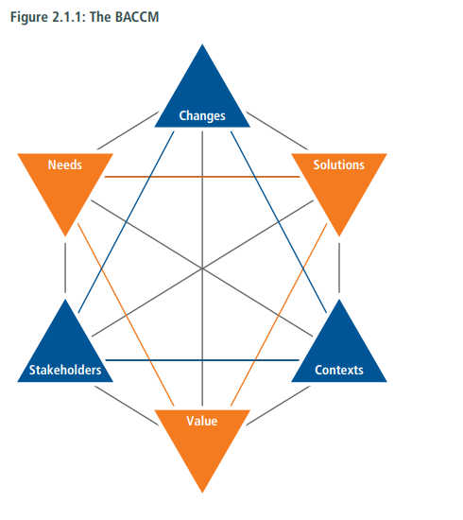
Concepts Connect

